Slide 1
waterfall or agile?
István Zsolt Berta
istvan@berta.hu
press F5 to play the animation

Slide 2
waterfall vs agile
gathers requirements, makes a plan and executes it
changing the plan is problematic, unwanted
customer feels benefits when plan is completed only
multiple iterations and continuous interaction with customer; less focus on planning
changes are embraced
frequent releases, adjustments made based on customer feedback

Slide 3
how waterfall works
1. requirements
2. system design
3. implementation
4. testing
5. deployment
6+. maintenance

Slide 4
waterfall example

Slide 5
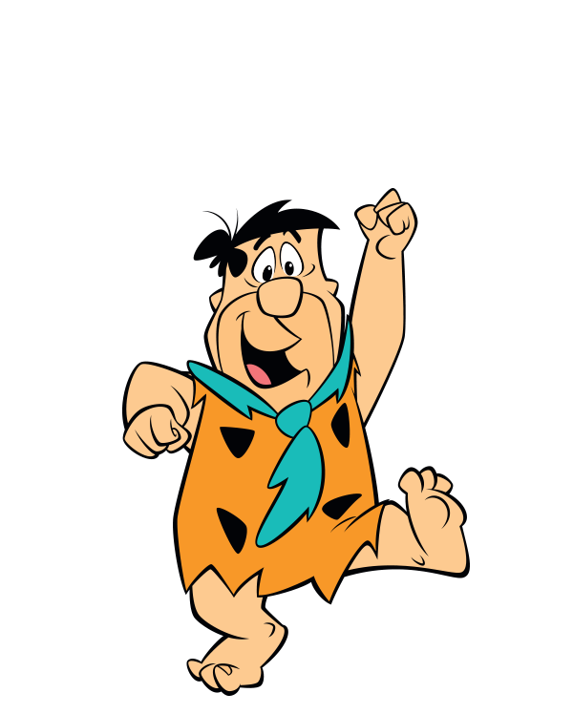
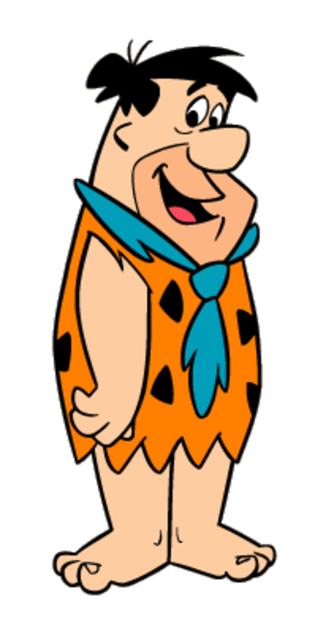
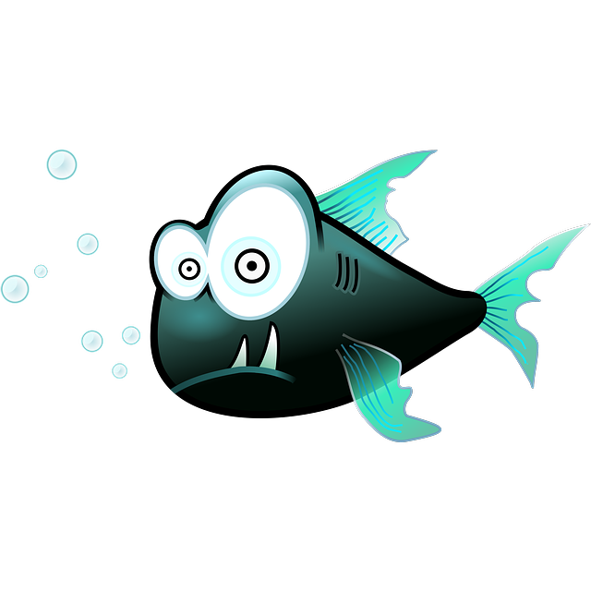
step 1: requirements
our customer...
... would like to get to the other side

Slide 6
step 2: system design
customer cannot cross yet

Slide 7
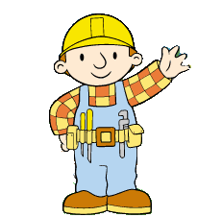
step 3: implementation
customer still cannot cross

Slide 8
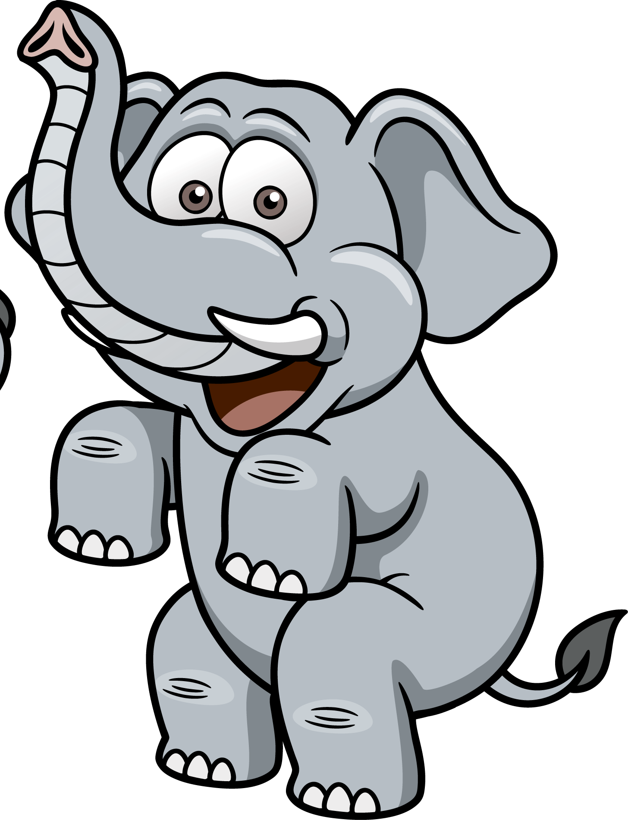
step 4: testing
customer still cannot cross

Slide 9
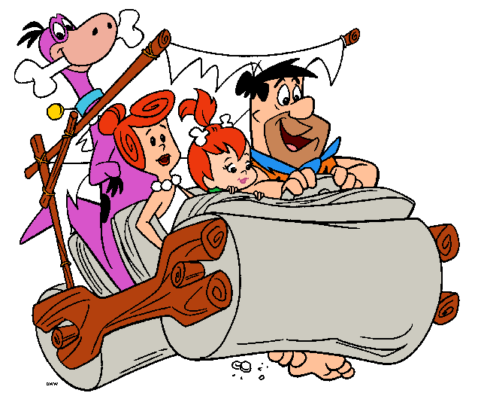
step 5: deployment
this is the first time customer can cross

Slide 10
step 6+: maintenance

Slide 11
however, waterfall may fail, if

Slide 12
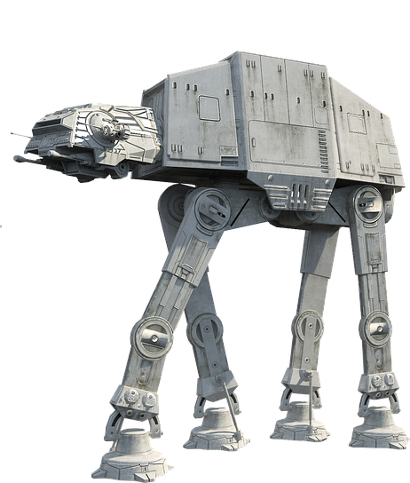
future capacity requirements not foreseen correctly
OOPS!
0

Slide 13
exact requirements were not known in advance

Slide 14
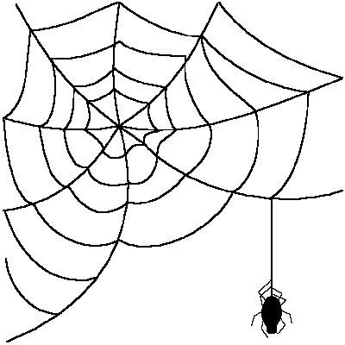
project exceeds budget and/or never finishes

Slide 15
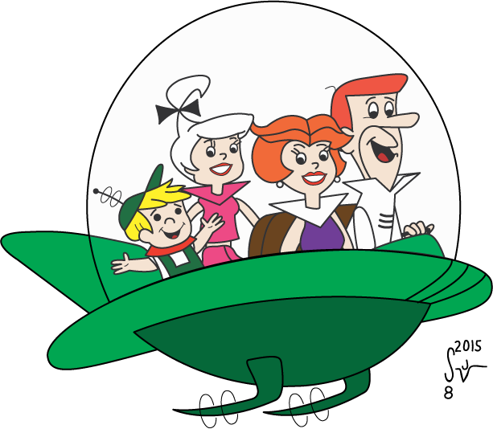
customer needs change and results are never used
wtf??

Slide 16
agile addresses these problems

Slide 17
how agile works
establish vision on what you want to achieve
release ’some’ deliverable in limited timeframe; deliverable must be directly useful for the customer, answering their need in some way
show deliverable to customer, gain their feedback
adjust what you want to do based on the feedback
→ go back to (1), unless customer is satisfied

Slide 18
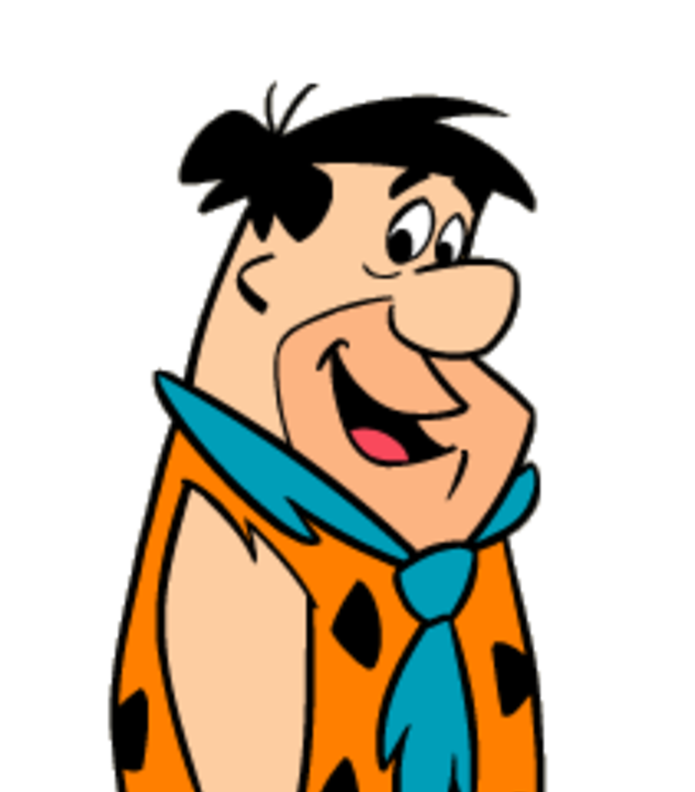
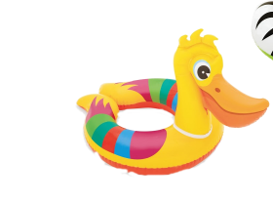
1st iteration: swim!
customer can cross, but solution is not user-friendly

Slide 19
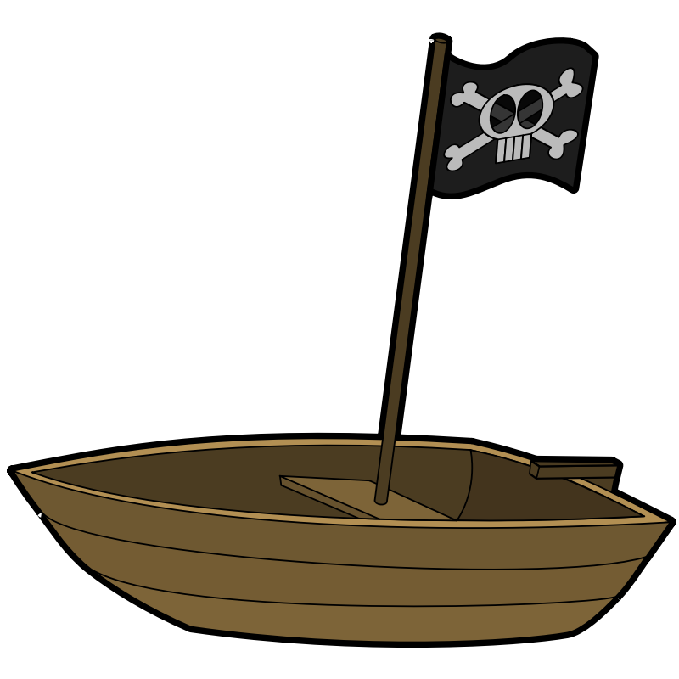
2nd iteration: a boat
more user-friendly but does not scale

Slide 20

3rd iteration: a rope
still not user-friendly, but a strategic step

Slide 21
next iteration: rope bridge
pedestrians can cross, but it is risky

Slide 22
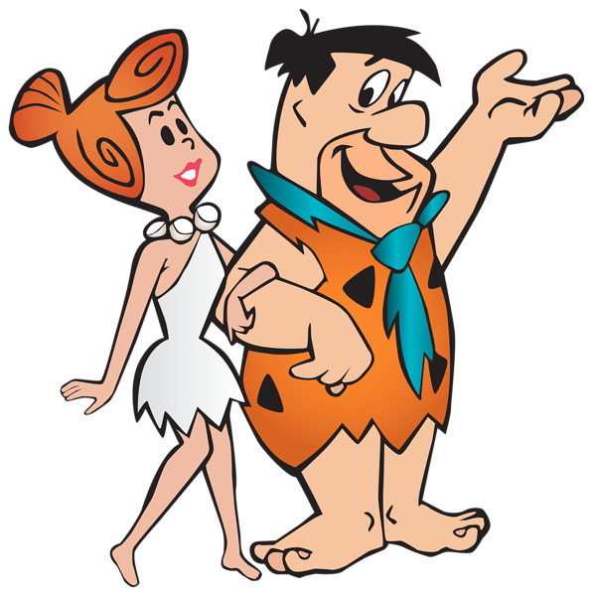
next iteration: wooden bridge
safe crossing, but pedestrians only

Slide 23
next iteration: concrete supports
almost done, more polishing needed

Slide 24
finally: solution accepted by customer
note: customer could cross from very 1st iteration

Slide 25
agile can also end up with something different, such as

Slide 26
customer might prefer boat (vs the expensive bridge)

Slide 27
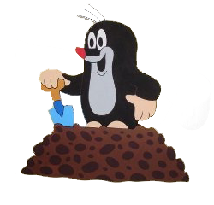
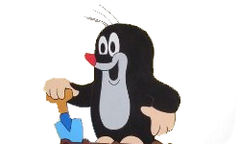

we may end up with a tunnel

Slide 28
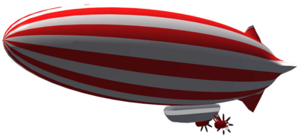
with a flying machine

Slide 29
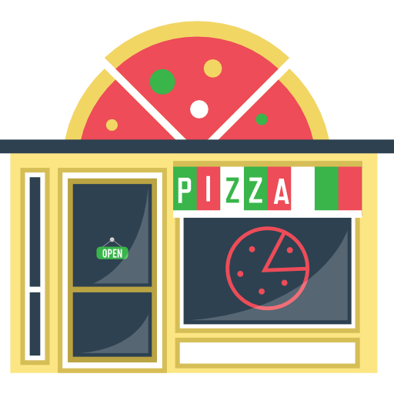
or we may end up with an Italian restaurant
why cross the river when we can have pizza on this side too?

Slide 30
if agile fails, it creates a real mess!

Slide 31
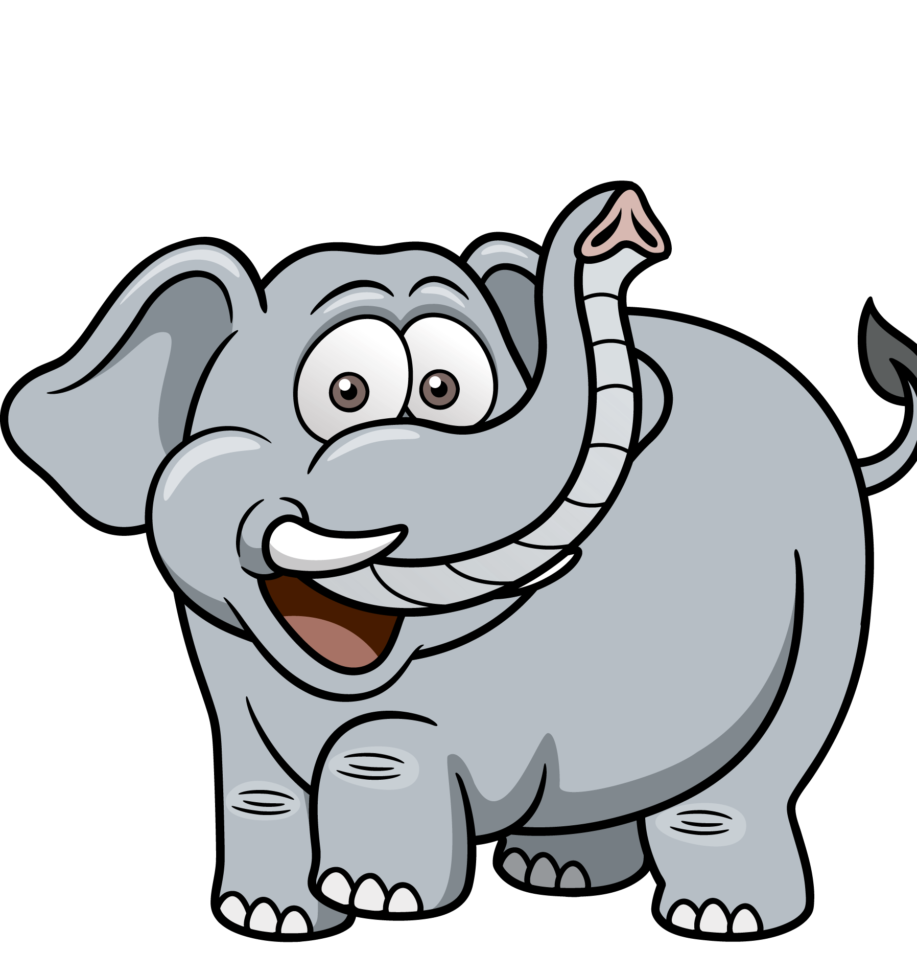
suboptimal, overly complex solutions (due to weak planning)

Slide 32
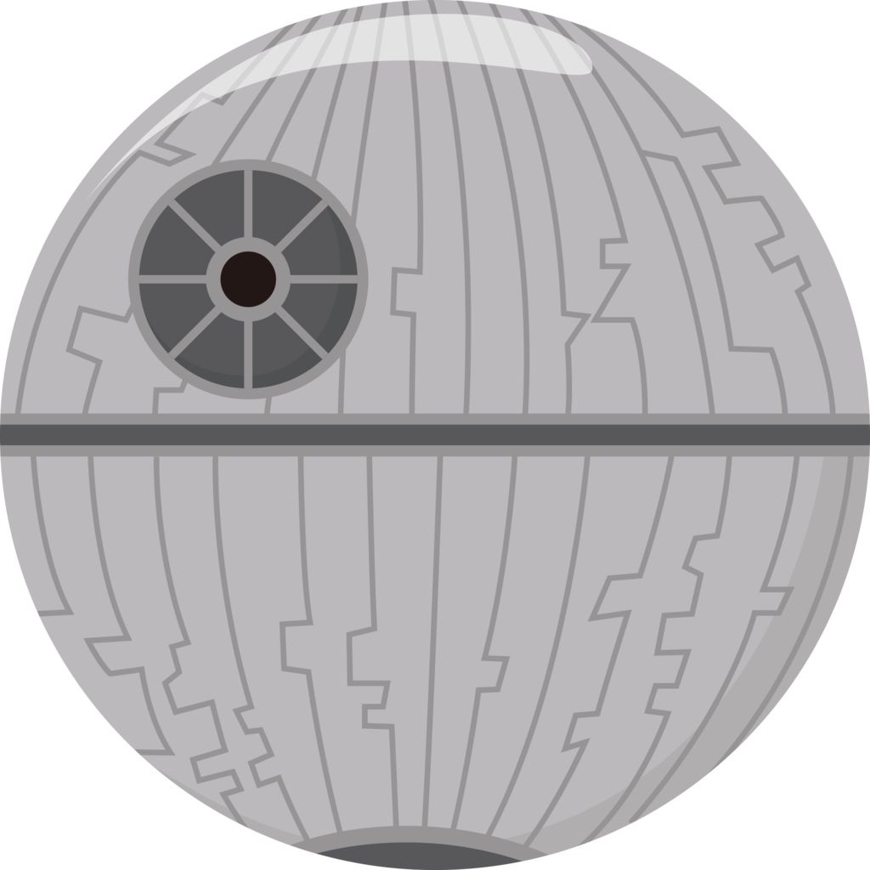
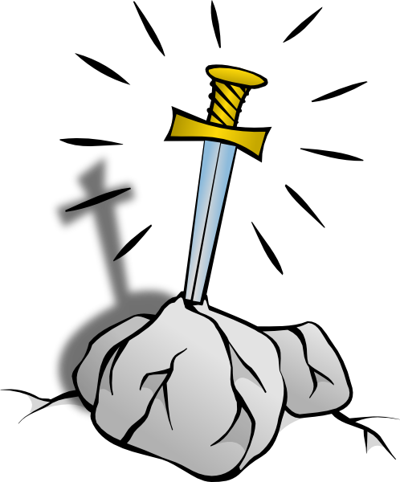
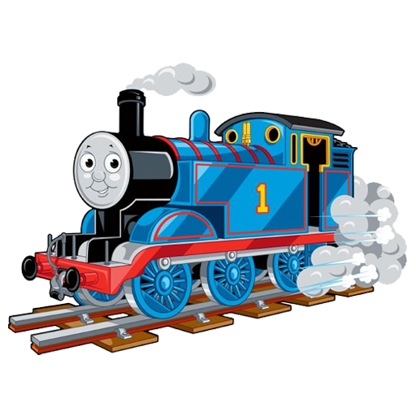
unrelated artifacts not answering the customer’s need (due to lack of vision)

Slide 33
or may fail just like waterfall (if you do not communicate with the customer enough)
0
words like sprint, epic, jira, scrum or nodejs do not make
you agile...

Slide 34
waterfall or agile?

Slide 35
waterfall can deliver the same results faster and cheaper... if customers can tell what they need agile will deliver something useful even if reqs are not known in advance

Slide 36
waterfall can better measure progress and can tell if you are in budget; …still, the project may fail completely agile will always deliver something; hard to foresee what exactly, and hard to plan budget & measure progress

Slide 37
waterfall is better at fulfilling a contract agile is better at making customers happy (if they accept uncertainty and if you can release quickly and get feedback)

Slide 38
Thanks!
this animation has been made for non-commercial purpose, for fun; characters (in bitmap images) are properties of their respective owners, like Hanna-Barbera, Disney, etc.; the rest of this animation – excluding the copyrighted bitmap images – has been created by istvan@berta.hu and is released on 2018-09-30 under Creative Commons CC BY 4.0

